Slide 1


The Effect of Lockdown on COVID-19 Cases and Death Trends in Egypt
Analysis from: March to May 2020
17,264
Total confirmed cases
764
4807
total death
Total recovered
Source: Egyptian Ministry of Health and Population

Slide 2
Content
1
Introduction
2
Hypothesis Testing result
3
visualization and analysis
4
potential issues
5
conclusion

Slide 3

Introduction
the rapid spread of COVID-19 has significantly impacted public health systems worldwide. Egypt, like many countries, implemented various measures such as lockdowns to control the spread of the virus.
Daily records from March 1 to May 24, 2020 (85 days).
Includes confirmed cases, deaths, recoveries, hospitalizations,
and lockdown status.

Slide 4
Hypothesis Testing result
Hypothesis 1:
H₀: There is no statistically significant difference in new confirmed cases during lockdown vs
non-lockdown periods.
H₁: New confirmed cases are significantly lower during lockdown periods.
Hypothesis 2:
H₀: There is no significant correlation between daily new confirmed cases and daily new
deaths.
H₁: There is a significant positive correlation between new confirmed cases and new
deaths
Test: T-test
t-test=6.08
p-value=3.382821785409008e-08
P<0.05
Reject H₀ - significant difference exists
Test: Pearson correlation coefficient
Correlation: 0.7
P-value: 1.2859892882614822e-17
P<0.05
Reject H₀ - significant correlation exists

Slide 5
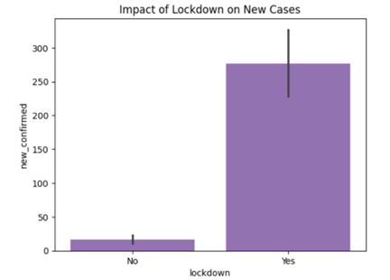
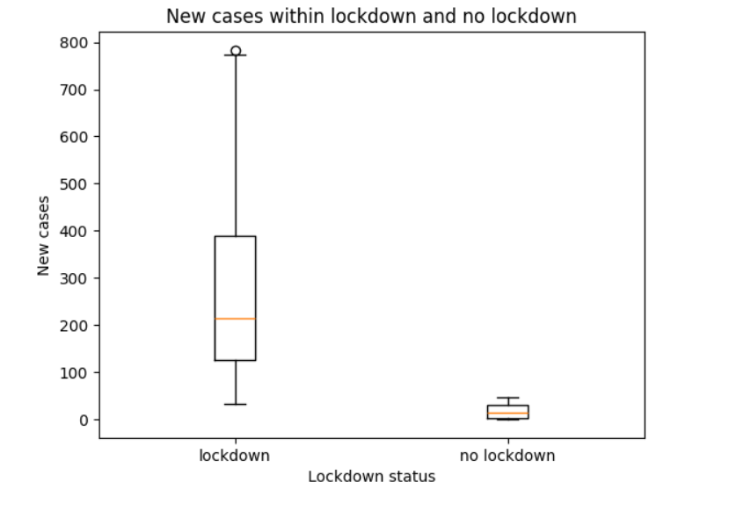
Visualization and analysis
This shows that lockdown has a strong impact on the number of new confirmed cases, as there is a clear difference between lockdown and non-lockdown periods.
According to the boxplot, the number of new confirmed cases appears to be higher during the lockdown period compared to the non-lockdown period. This suggests that the lockdown did not correspond with a decrease in cases.

Slide 6
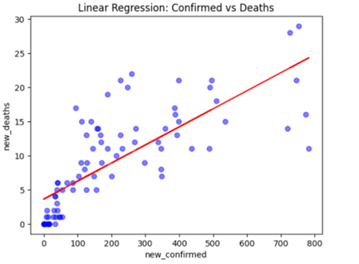
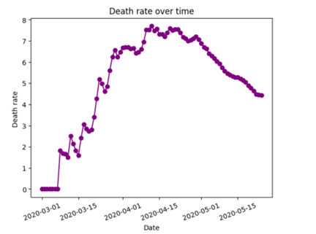
Visualization and analysis
There is a positive linear relationship between new confirmed cases and deaths
initial was zero the cases was zero as time passes virus started spreading more and death rate increases

Slide 7
potential issues
1)Small dataset size (85 observations)
2)Limited Variables(cases, deaths, recoveries, lockdown, etc.). This can lead to omitted variable bias
3)Correlation ≠ Causation: correlation does not imply causation, meaning that a relationship between two variables does not necessarily indicate that one causes the other
4)Lockdown Variable Simplification: The lockdown variable is treated as a simple Yes/No value.
5)Limited Hypothesis Testing: small number of hypotheses were formally tested

Slide 8
conclusion
This study confirms that lockdown measures in Egypt significantly changed the trend of daily COVID-19 cases.
The results of the t-test showed a statistically significant difference in the number of daily confirmed cases between lockdown and non-lockdown periods, leading to the rejection of the null hypothesis. This suggests that lockdown measures had a significant effect on changing the number of new COVID-19 cases in Egypt.
the Pearson correlation test indicated a significant positive relationship between daily confirmed cases and daily deaths. As a result, the null hypothesis was also rejected for the second test, meaning that increases in confirmed cases are associated with increases in deaths.

